Slide 1

Business Performance Dashboard Presentation BY Mariam Ayman

Slide 2
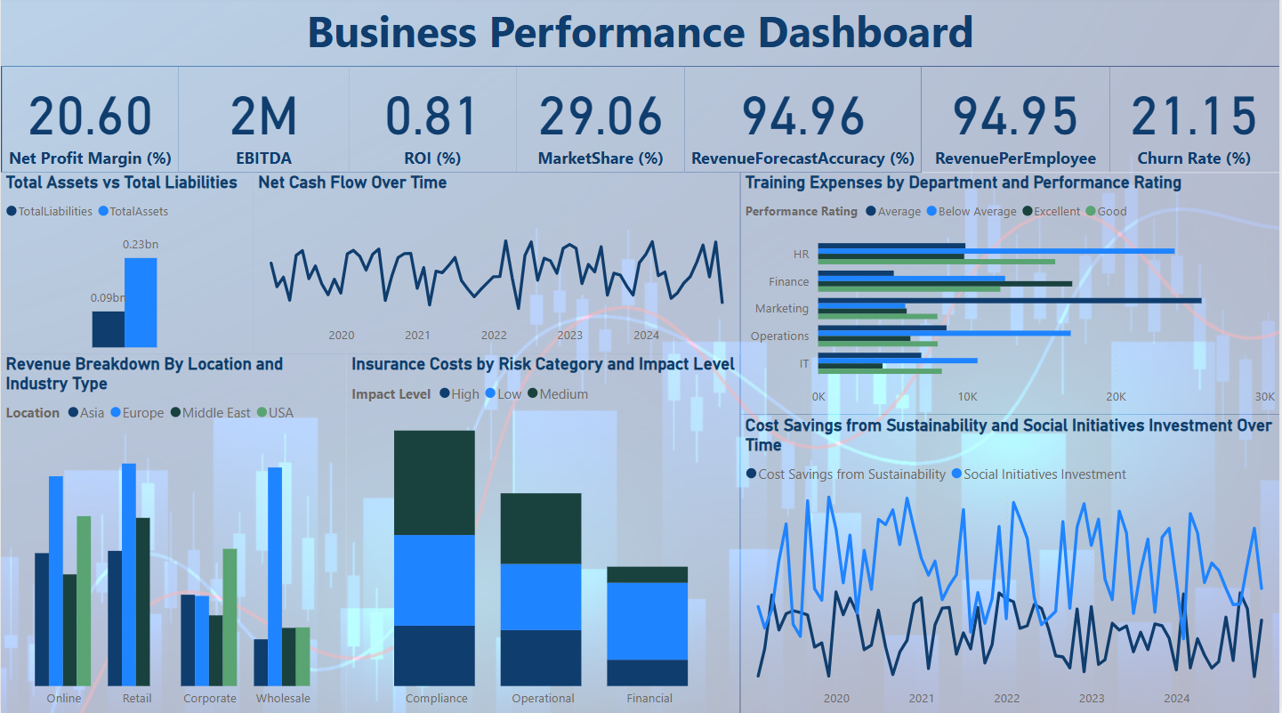
Content
- This dashboard provides a comprehensive view of key business metrics to support strategic decision-making.
- It covers financial performance, revenue trends, risk management, employee efficiency, and sustainability efforts.
- By analyzing these insights, business leaders can make data-driven decisions to enhance profitability, mitigate risks, and optimize resources.

Slide 3
Understanding Business Financial Health - EBITDA (2M): Strong earnings before interest, taxes, depreciation, and amortization indicate solid financial performance. - Net Profit Margin (20.60%): A healthy profitability metric showing efficient cost management. - ROI (0.81%): Relatively low, highlighting potential areas to enhance investment efficiency. - Market Share (29.06%): A strong competitive position in the market. - Client Churn Rate (21.15%): A high churn rate suggests customer retention challenges that need to be addressed to maintain steady growth. Key Insight While profitability and market share are strong, the ROI and Churn Rate indicate the need for investment optimization and customer loyalty strategies.

Slide 4
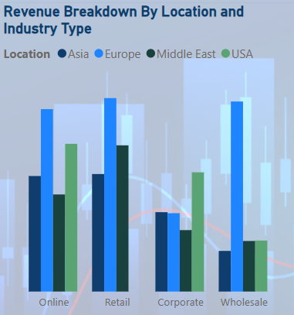
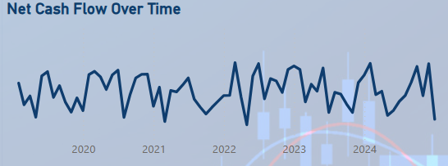
Analyzing Revenue Distribution And Growth Patterns - Revenue By Location: USA and Asia contribute the highest revenue, while other regions lag. - Revenue By Industry Type: Retail and online sales are the strongest revenue streams, while wholesale generates lower revenue. - Net Cash Flow Trends: revenue fluctuates but shows an overall upward trajectory, indicating business growth. - Forecast Accuracy (94.96%): High accuracy in revenue projections ensures reliable financial planning. Key Insight The focus should be on strengthening high-performing regions and industries while identifying opportunities to enhance underperforming areas.

Slide 5
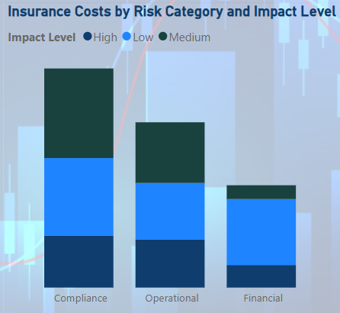
Evaluating Business Risks And Cost Impact - Insurance Costs: Compliance and operational risks have the highest insurance costs, requiring better risk mitigation. - Risk Impact Levels: High-risk categories pose financial threats and need proactive strategies. - Operational And Compliance Costs: These risks contribute significantly to financial strain, making risk management a top priority. Key Insight Strengthening compliance protocols and operational efficiency can significantly reduce insurance costs and financial risks.

Slide 6
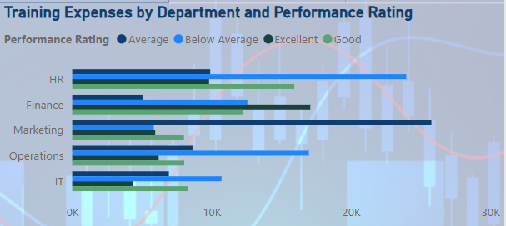
Optimizing Workforce Efficiency - Training Expenses By Department: IT and marketing departments receive the most training investment, while HR and finance have lower training allocations. - Performance Ratings: Departments with lower ratings, such as HR and finance, may need additional support and training. - Revenue Per Employee (94.95): A strong metric, but further efficiency improvements could drive even higher returns. Key Insight Aligning training investments with performance needs will enhance workforce productivity and overall business efficiency.

Slide 7
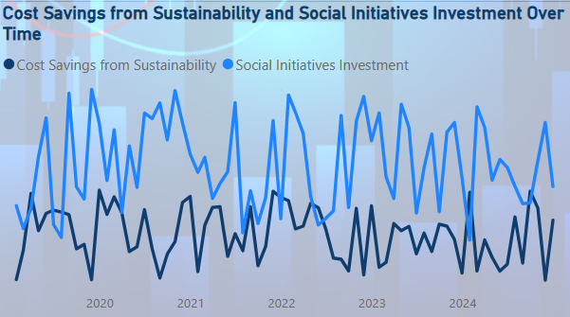
Measuring The Impact Of Sustainability Investments - Cost Savings From Sustainability Initiatives: Increasing over time, demonstrating the financial benefits of green investments. - Social Initiative Investments: Fluctuating investment levels indicate inconsistent commitment to social responsibility efforts. - Long-term Business Impact: Companies that maintain steady ESG investments tend to experience long-term financial and brand benefits. Key Insight To maximize the impact, businesses should maintain a steady investment in sustainability and social responsibility programs.

Slide 8
Strategic Actions Moving Forward - Client Retention Strategy: Implement personalized engagement and loyalty programs to reduce churn. - Risk Reduction Measures: Invest in compliance tools and process improvements to minimize high-risk areas. - Revenue Expansion: Develop targeted marketing strategies to enhance sales in underperforming regions. - Sustainability Commitment: Ensure a balanced and consistent approach to ESG investments for long-term brand and financial benefits. - Performance Monitoring: Regularly review KPIs and adjust strategies as needed to stay aligned with business goals. By leveraging data-driven insights from this dashboard, we can make informed decisions to strengthen our financial performance, optimize operations, and build a sustainable future for the business.

